Slide 1
Text Mining
on
Yelp Reviews

Slide 2
PROJECT
OVERVIEW
The main objective is to perform sentiment analysis and create a model for insights.
Steps to achieve this objective :
Data Description
Data Loading
Data Pre-processing
Data exploration
Identifying Model features
Sentiment Analysis
Correlation between Model Features
Interpreting the results
Conclusion

Slide 3

Data Description
10,000 Yelp reviews with 10 columns from Kaggle.
Text data: Text of review
Other attributes: Stars, Cool, Useful, Funny
Stars is a categorical variable with the number of stars the reviewer gave, from 1 to 5
Cool, Useful, and Funny are numerical variables with the number of votes the review got from other users in the 3 categories

Slide 4
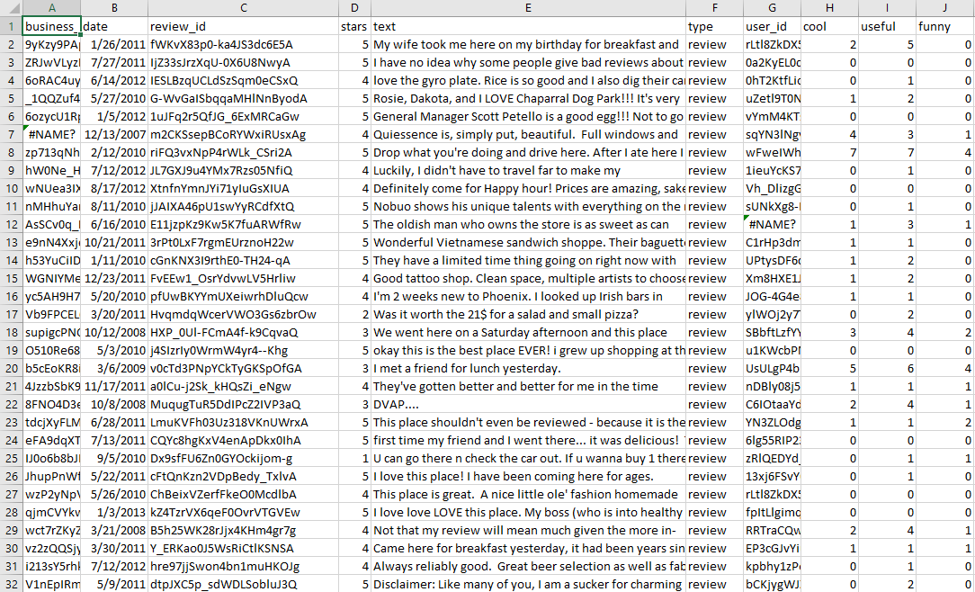

Slide 5
Data Loading and Data Pre-processing
Loading the Data from CSV
Removing the new lines
Putting all reviews in the List

Slide 6
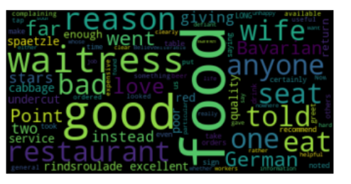
Data Exploration

Slide 7
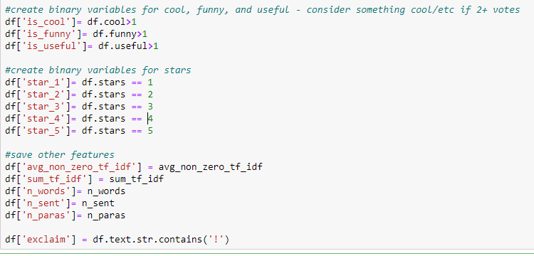
Identifying Model features
We Identified the Model features for our Data Set
Cool, Funny, Useful and Total number of Stars
Number of words, sentences, and paragraphs

Slide 8
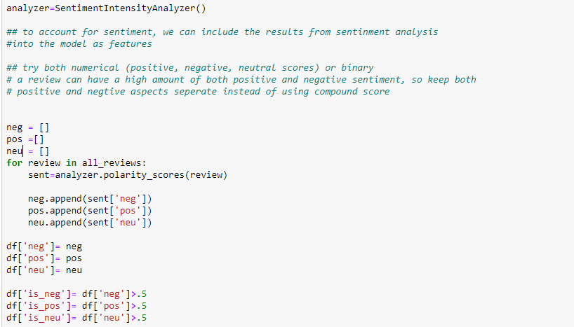
Sentiment Analysis with VADER

Slide 9
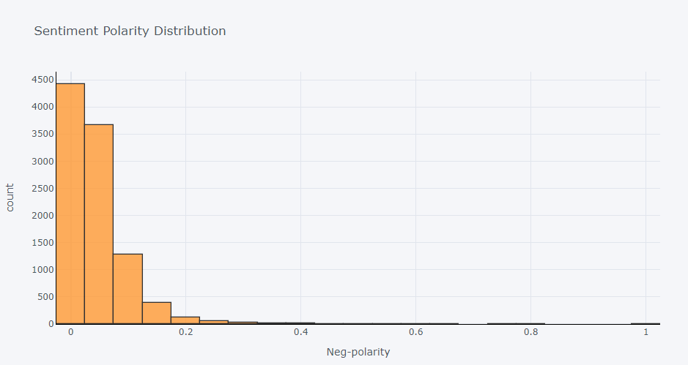

Slide 10
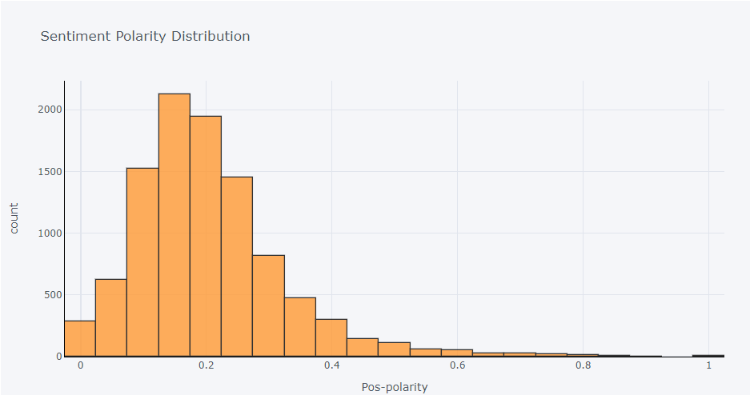

Slide 11
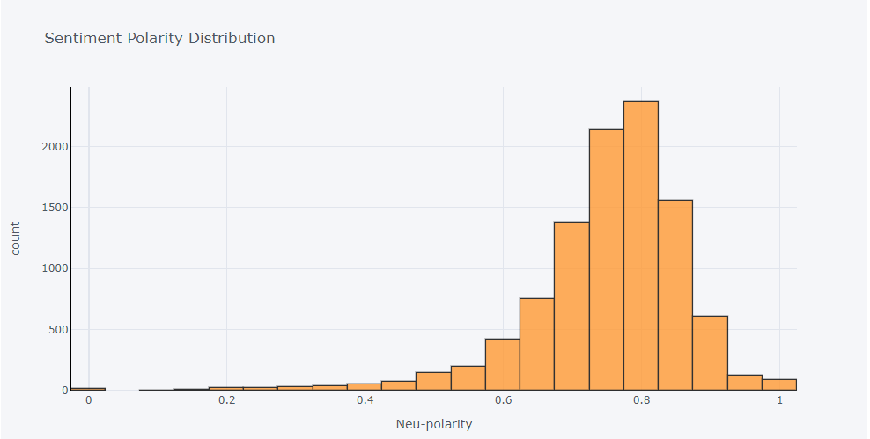

Slide 12
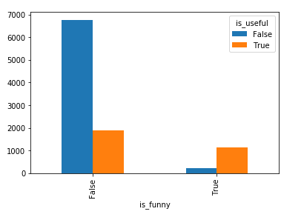
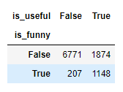
Cross-Tabulation between Model Features (Funny vs Useful)

Slide 13
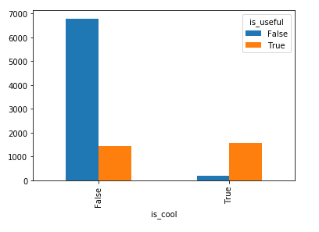
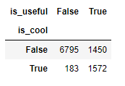
Cross-Tabulation between Model Features (Cool vs Useful)

Slide 14
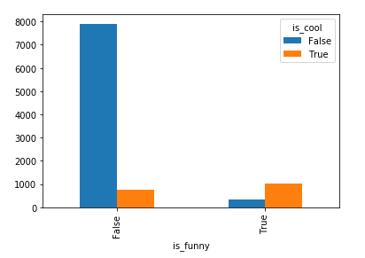
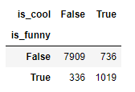
Cross-Tabulation between Model Features (Funny vs Cool)

Slide 15
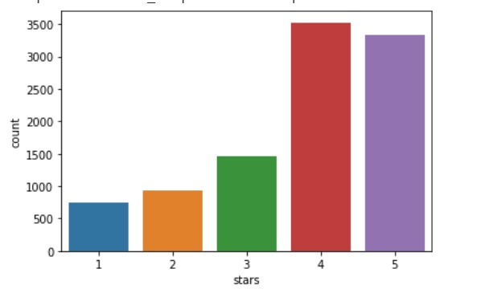
Stars Distribution

Slide 16
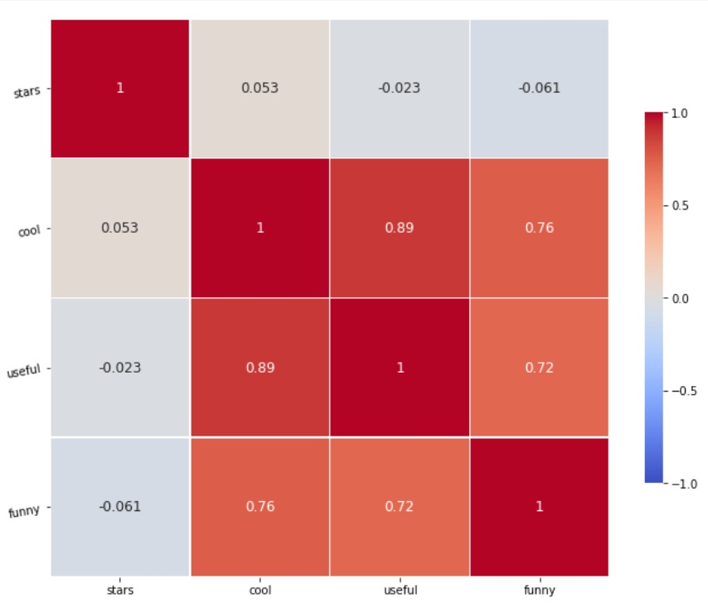
Heat Map

Slide 17
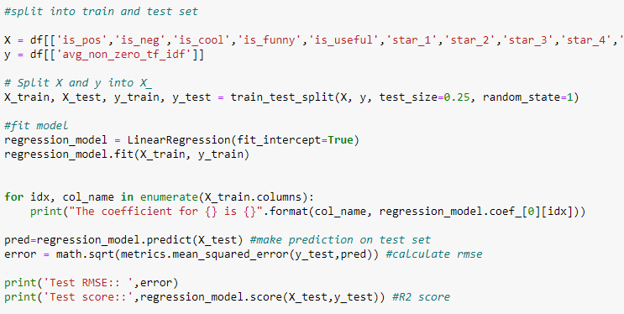
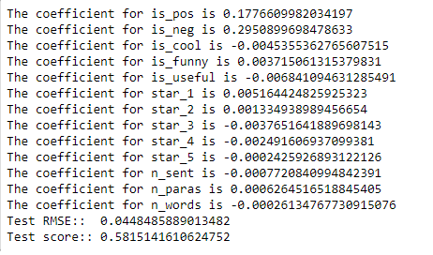

Average TF- IDF over non zero values

Slide 18
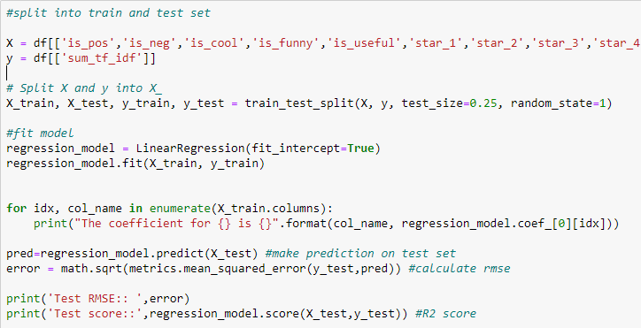
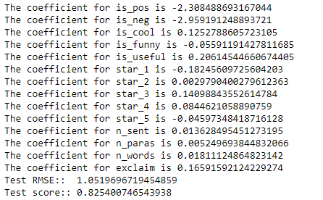
Sum of TF-IDF over all words

Slide 19
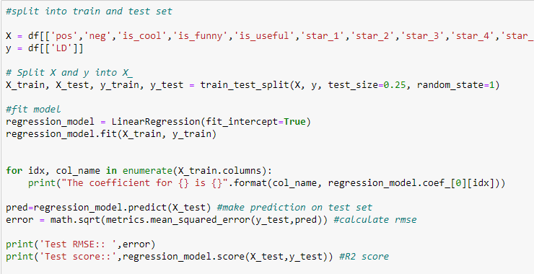
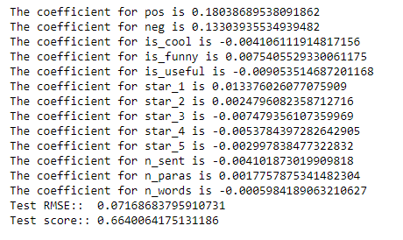
Lexical Diversity

Slide 20
Conclusion
We were able to create linear models for text quality that controlled for different features of a review.
'Useful' has negative relationships with lexical diversity and average non-zero of TF-IDF.
This suggests that lexical diversity and average non-zero of TF-IDF are not measuring Yelp review quality since usefulness has a negative relationship with these measures.
Sum of TF-IDF may a better quality measure.
Even though cool and funny usually align, they contribute in opposite directions in the linear models.

Slide 21
Q & A
Thank You

